Slide 1

Predicting Sales Trends and Consumer Preferences on Amazon
Emily Picinich
Notes:
Hello everyone. My name is Emily Picinich, and I’ll be presenting my project on Predicting Sales Trends and Consumer Preferences on Amazon.
The goal of this analysis was to better understand what factors drive consumer purchasing behavior on Amazon and how predictive models can help sellers make more informed decisions.
By the end, I hope to provide not only technical findings but also practical takeaways that could apply to e-commerce strategy more broadly. Let’s get started.

Slide 2
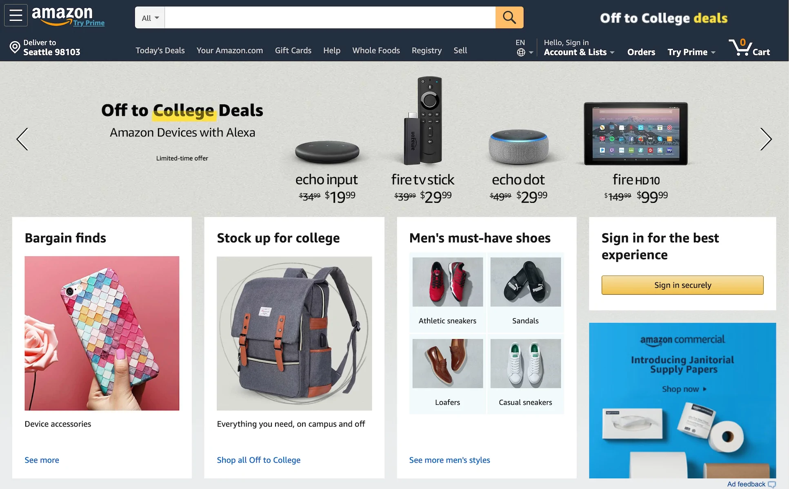
Dataset Overview
Source: Kaggle, 2025 release
Size: ~42K products with structured attributes
Key Features:
Product information: title, category, badges, sustainability tags
Pricing: listed price, discounted price
Consumer engagement: ratings, number of reviews, recent purchases
Goal: identify factors that influence product sales and consumer preferences
Notes:
This project uses the Amazon Products Sales Dataset from Kaggle, with about 42,000 items. It includes product details like categories and badges, pricing information, and engagement metrics such as ratings and reviews. The goal is to identify which features drive sales and consumer preferences, and to test how well machine learning models can predict these outcomes.

Slide 3
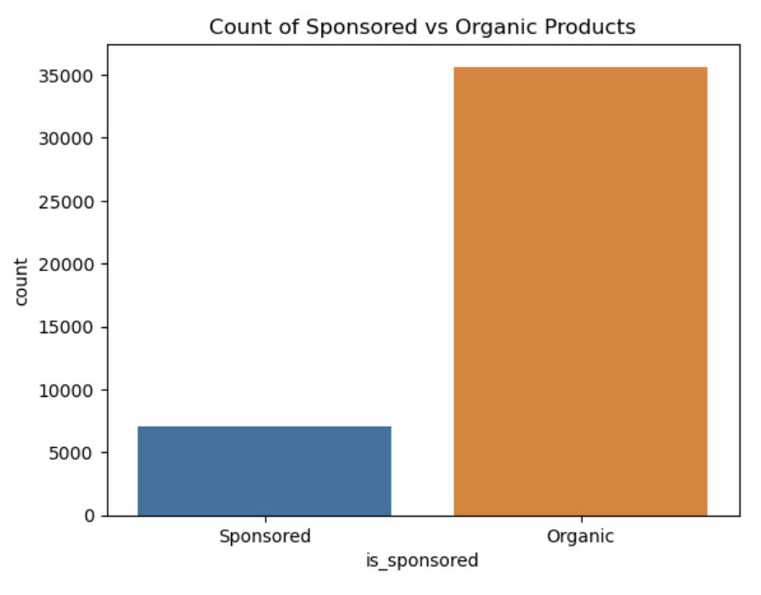
Sponsorship vs. Organic Performance
Most consumer purchases are driven by organic products, not paid sponsorships.
Sponsorship drives sales but may compromise customer perception.
Notes:
What we see when we look at the role of sponsorship is that most consumer purchases are actually driven by organic products, meaning items that succeed without paid sponsorships.
While sponsorship can increase visibility and help drive sales, it’s not the dominant factor overall. In fact, the data suggests that relying too heavily on sponsorship may compromise customer perception, as shoppers may value organic popularity and authenticity more than paid promotion.
This tells us that although sponsorship has its place, long-term success on Amazon is more strongly tied to organic product appeal and customer trust.

Slide 4
Effects of Sponsorship
Sponsored products sell substantially more in the short term.
Cohen’s d = 1.22
Reviews show only minor differences between Sponsored and Organic.
Cohen’s d = 0.08
Sponsored products have slightly lower ratings on average.
Cohen’s d = -0.13
Sponsorship drives short-term sales, but not long-term engagement, and may affect perceived quality.
Notes:
Sponsorship has a strong impact on short-term sales, with sponsored products selling much more than organic ones. But when it comes to long-term engagement, like reviews, the difference is minimal. Interestingly, sponsored products tend to get slightly lower ratings, suggesting a trade-off, where promotion boosts visibility and sales, but it may not improve, and could even affect, perceived quality.

Slide 5
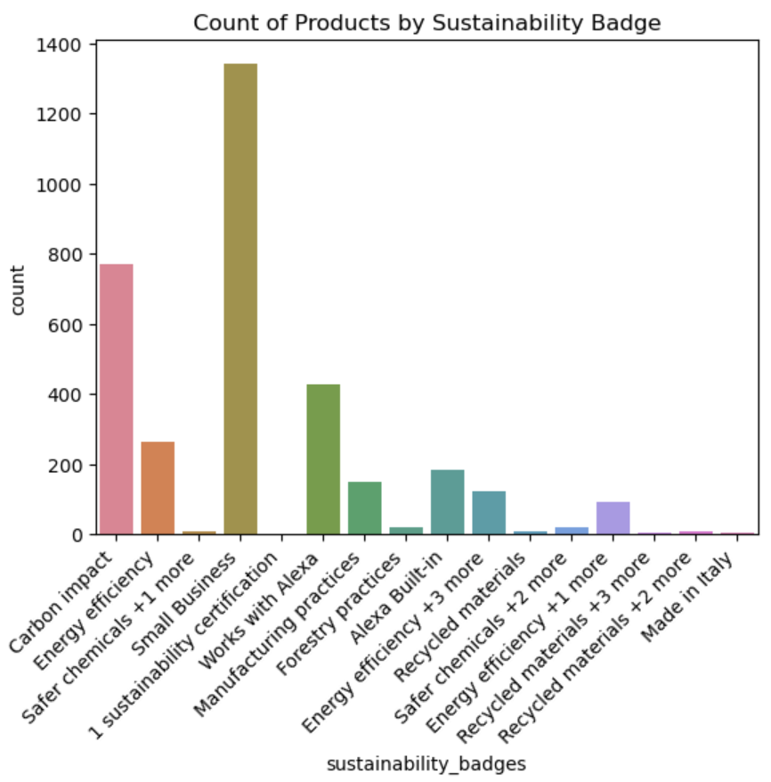
Sustainability Badges
Sustainability badges are rare.
Over 90% of products carry no badge.
A few niche labels like “Small Business” stand out.
Notes:
Looking at the sustainability badges on Amazon, what stands out immediately is how rare these badges are; over 90% of products don’t carry any sustainability label at all.
Among the products that do have them, only a handful of niche categories, like the ‘Small Business’ badge, appear more frequently. Other labels, such as carbon impact or recycled materials, are present but in very small numbers.
This suggests that while sustainability badges may carry symbolic or marketing value, they aren’t yet a widespread driver of sales across the platform.

Slide 6
Effects of Sustainability Badges
Products with and without badges show similar purchase levels.
Badges are linked to slightly higher ratings (4.4 vs 4.28).
Products with badges accumulate more reviews, suggesting greater trust or perceived quality.
Badges appear to shape long-term perception rather than short-term impact.
Notes:
Products with and without sustainability badges sell at similar levels, so badges don’t drive short-term sales. But products with badges tend to earn slightly higher ratings and more reviews, suggesting stronger trust and engagement. Overall, these badges matter more for shaping long-term perception and brand credibility than for boosting immediate purchases.

Slide 7
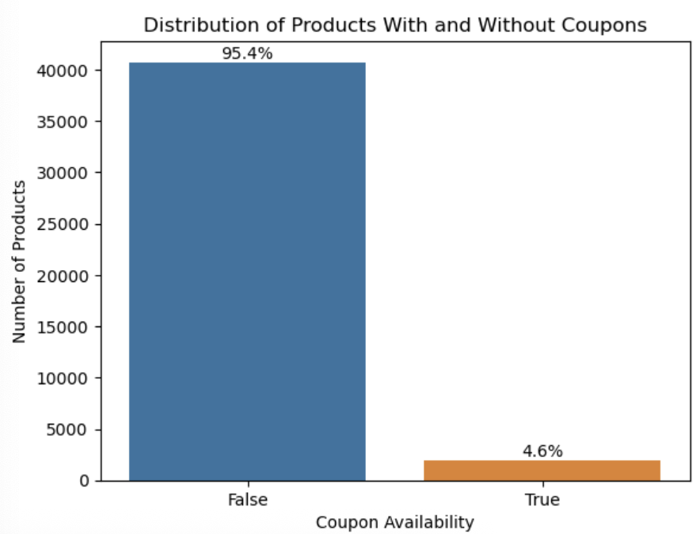
Coupons
Coupons are rare: only 4.6% of products offer them.
Most sellers rely on base pricing rather than discounts.
Imbalance matters for modeling, as predicting “no coupon” would be correct most of the time.
Notes:
This chart shows that coupons are rare; only about 4.6% of products have them, while over 95% do not. This suggests sellers mostly rely on base pricing and use coupons selectively. For modeling, this imbalance matters because predicting ‘no coupon’ could look accurate, so it’s important to test whether coupons actually influence purchases.

Slide 8
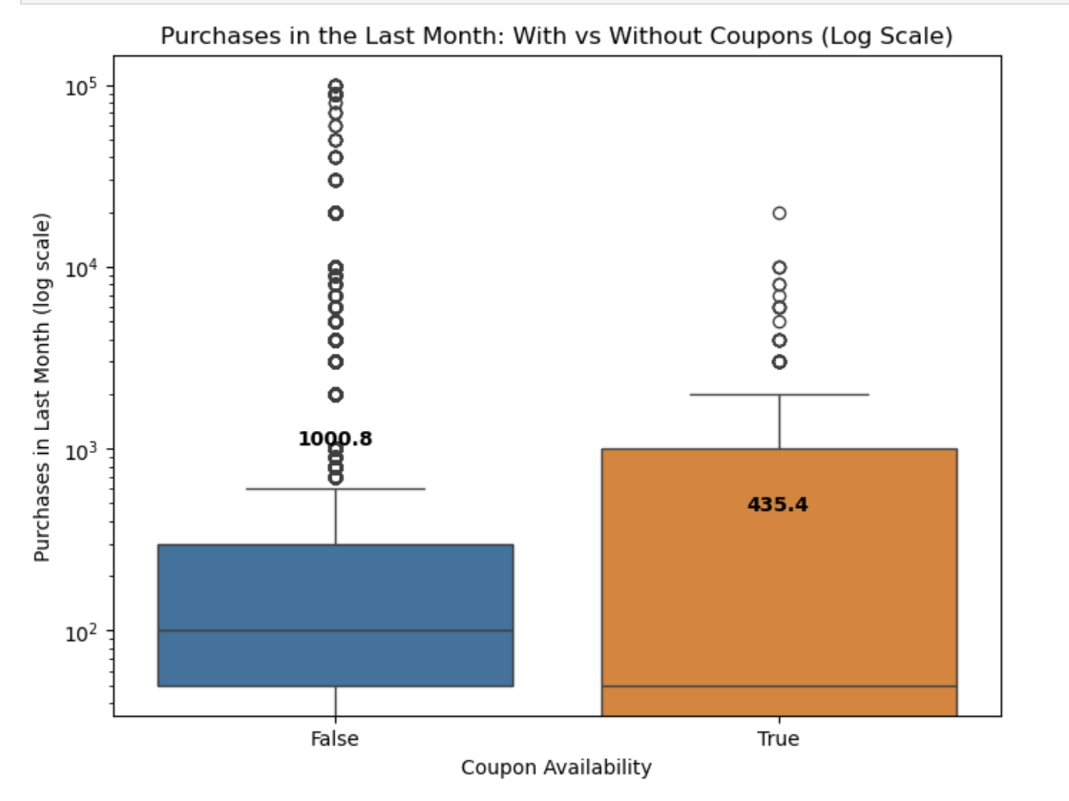
Effects of Coupons
Products without coupons show significantly higher purchase activity.
Median purchases:
Coupon = 50
No coupon = 100
Statistical tests confirm strong, significant difference.
Small effect size (Cohen’s d = 0.21) means that non-coupon products have a slight advantage.
Coupons do not boost overall sales volume, even though some couponed products still dominate at the top end.
Notes:
Looking at the effects of coupons on purchase behavior, what we see is that products without coupons actually show significantly higher purchase activity. The median number of purchases for couponed items is around 50, while for non-coupon items it’s about 100.
Statistical testing confirms this difference is highly significant. However, the effect size is small, with Cohen’s d at 0.21, meaning that while the difference is real, it’s not very large in practical terms.
Overall, this suggests that coupons do not consistently boost sales volume across the dataset. While a few couponed products still perform strongly at the top end, the broader trend shows that non-coupon products tend to have a slight advantage.

Slide 9
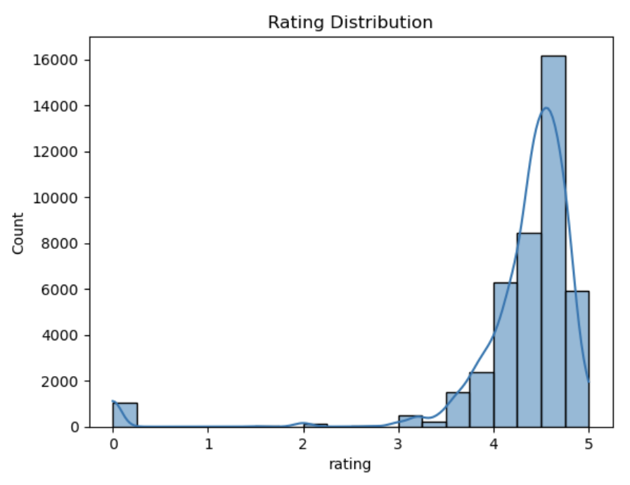
Ratings
Ratings are highly skewed toward positive values.
Most cluster between 4.0-5.0, with a sharp spike around 4.5-4.8.
Negative ratings (below 3.0) are extremely rare.
Ratings reflect general satisfaction but have limited predictive power.
Best used as a supporting feature rather than a main predictor.
Notes:
This chart shows the distribution of product ratings. We can see that ratings are overwhelmingly positive, with the vast majority clustering between 4 and 5, and a sharp spike around 4.5 to 4.8. Negative ratings, below 3, are very rare. This suggests that most customers leave positive reviews, so while ratings do reflect general satisfaction, they don’t provide much variation for predictive modeling. Instead, ratings may be more useful as a supporting feature alongside stronger drivers like price or product attributes.

Slide 10
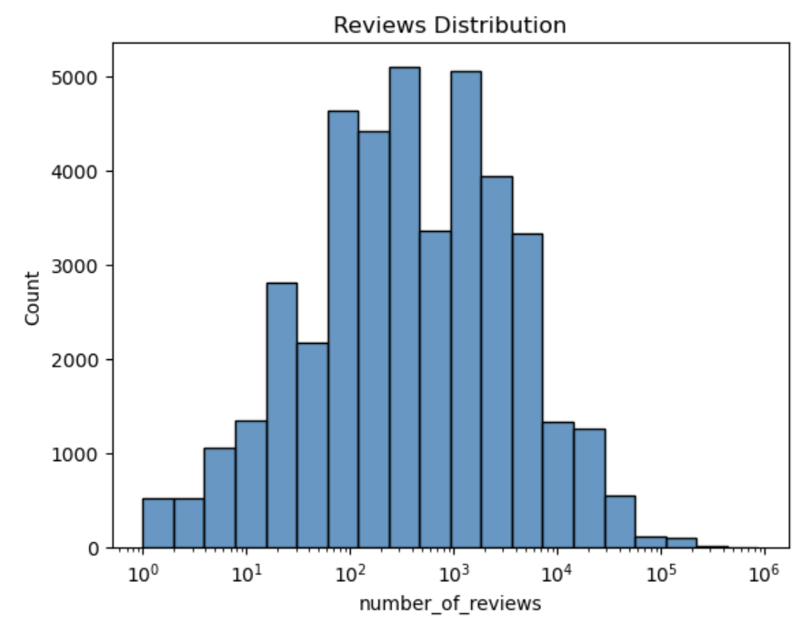
Number of Reviews
Most products have 10-10,000 reviews, peaking in the hundreds to a few thousand.
A few products have extremely high review counts (10,000+), dominating visibility.
Some products have very few reviews (1-10), reflecting limited engagement.
Distribution supports a ”winner-takes-most” dynamic, where a small group of products dominate attention.
Notes:
This chart shows that most products have between 10 and 10,000 reviews, giving buyers enough feedback. But there’s a long tail; some items have over 100,000 reviews, while others have very few. This reflects a ‘winner-takes-most’ pattern, where a small group of products dominate visibility. Next, we’ll see if this same trend appears in sales.

Slide 11
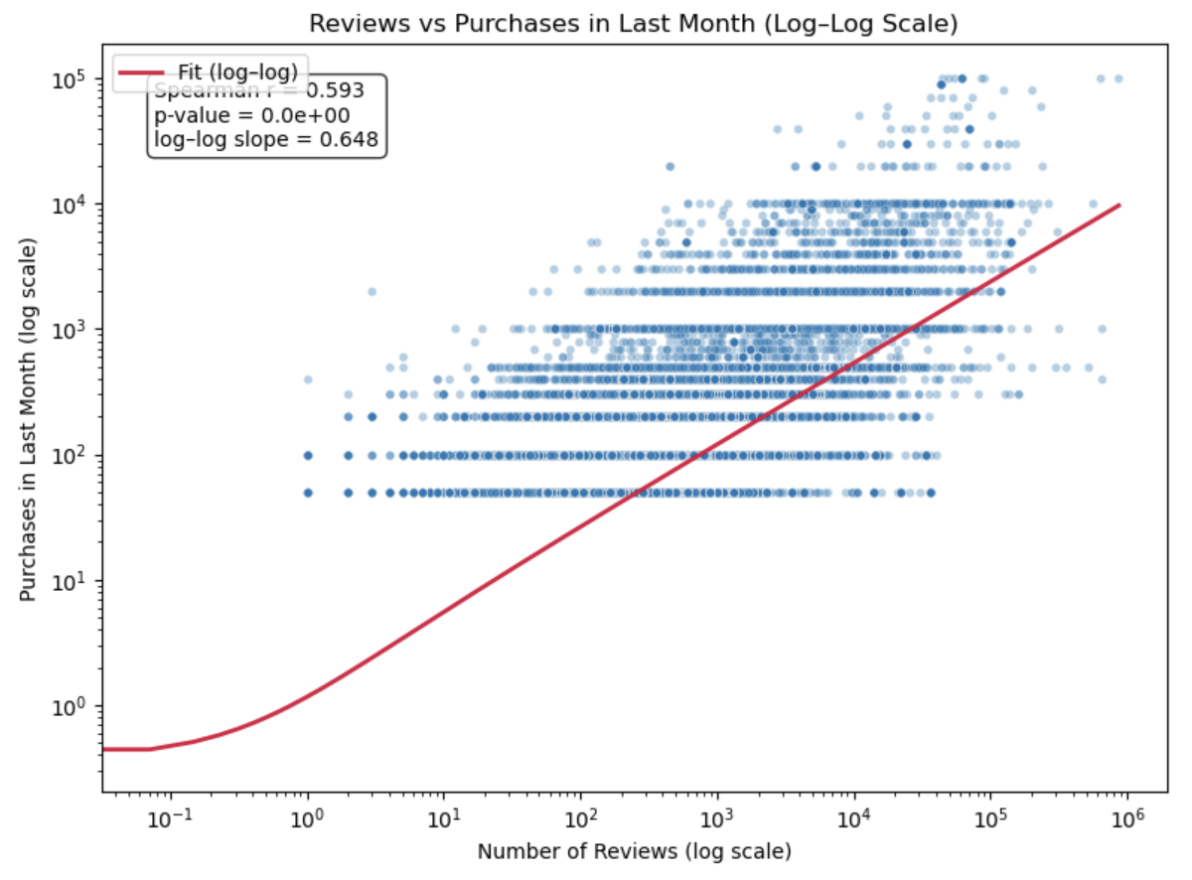
Effects of Reviews
Strong positive relationship between reviews and purchases.
Purchases grow sublinearly with reviews.
A 10x increase in reviews leads to ~4x increase in purchases.
Reviews are a good but imperfect proxy for sales, showing saturation effect at high counts.
Popularity boosts visibility, but extra reviews don’t always equal proportional sales growth.
Notes:
This chart explores the link between reviews and purchases. On the log–log scale, we see a clear positive relationship, where products with more reviews generally also have more purchases, and the correlation is fairly strong at about 0.59.
What we also see here is that purchases grow sublinearly with reviews. So reviews definitely help drive sales, but there are diminishing returns. In other words, reviews are a strong signal of popularity, but not a one-to-one driver of purchases.

Slide 12
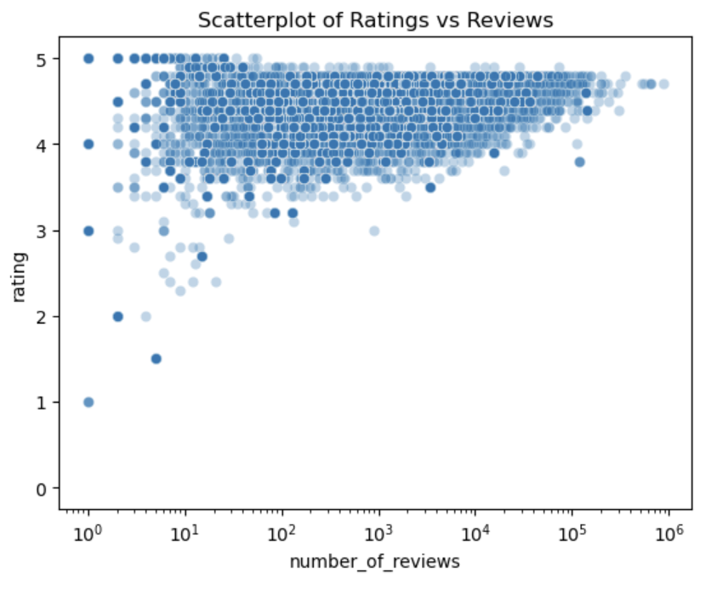
Ratings vs Reviews
Ratings cluster between 4.0-5.0, showing consistently positive feedback.
Products with few reviews show volatile ratings.
Heavily reviewed products stabilize around 4.2-4.6 stars.
High ratings are common, so they don’t strongly distinguish product success.
Notes:
This scatterplot shows that ratings consistently cluster between 4 and 5 stars. Products with only a few reviews are more volatile, but as review counts grow, ratings stabilize around 4.2 to 4.6. The main takeaway is that ratings are overwhelmingly positive and stable, so they don’t strongly distinguish successful products since most items are highly rated.

Slide 13
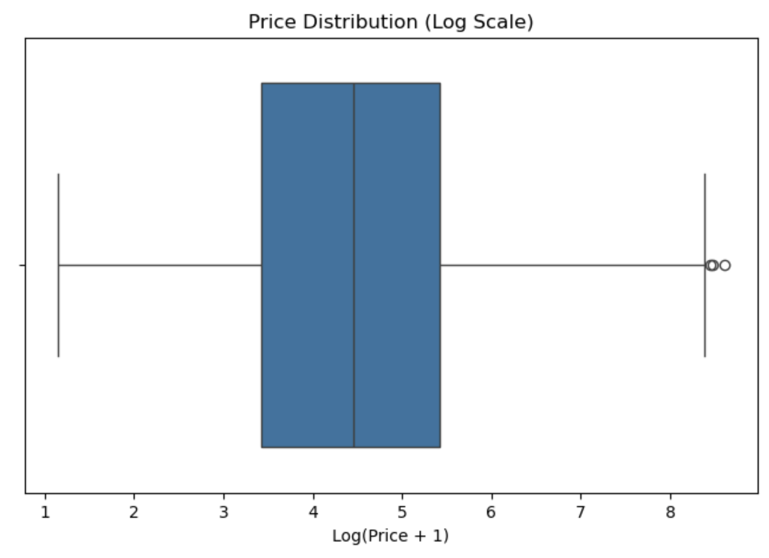
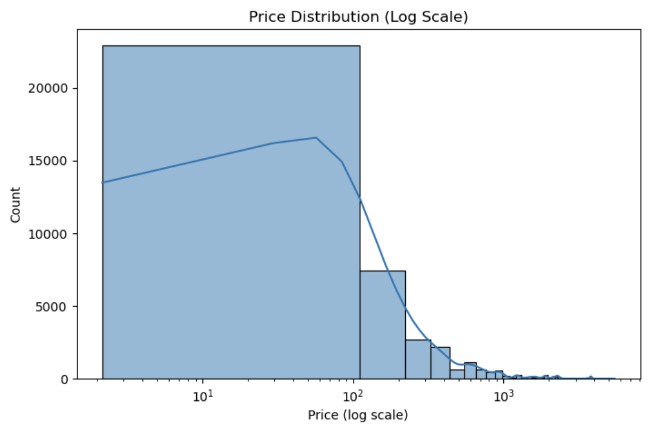
Pricing
Most products are priced low, clustered between $10-100.
Median price is around $70-75 (after log transformation).
A few extreme outliers push prices above $1,000, even beyond $5,000.
Distribution is highly skewed by overall affordability dominates.
Notes:
When we look at pricing across the dataset, most products fall in the affordable range, between about ten and one hundred dollars, with a median around seventy to seventy-five. There are a handful of extreme outliers priced over a thousand, even as high as five thousand, but these are rare. The distribution is highly skewed, and after applying a log transformation, it becomes clear that affordability dominates, as the dataset mostly reflects low to mid-priced items, which drive the bulk of sales.

Slide 14
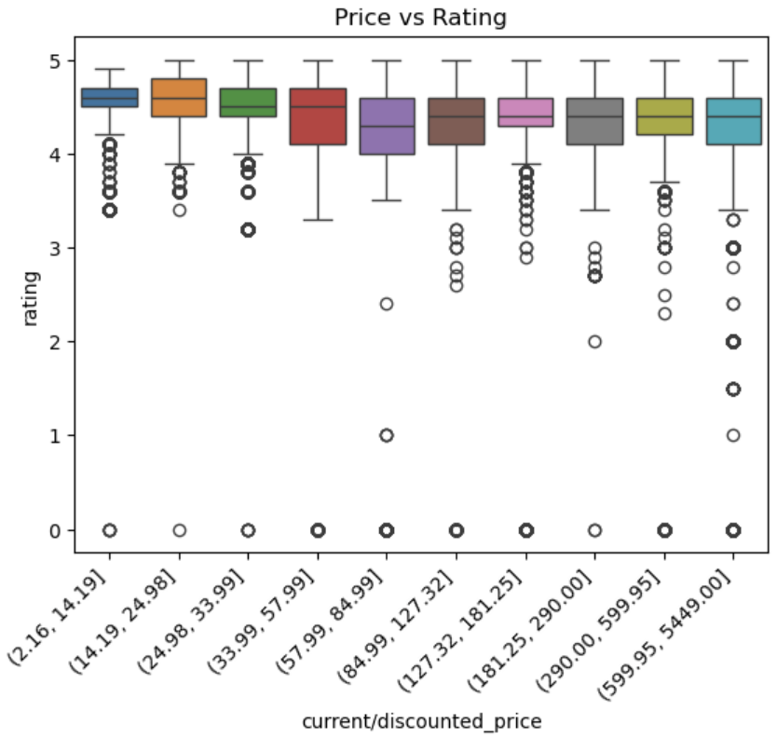
Ratings Across Price Ranges
Ratings stay consistently high across all price ranges.
Low-priced and high-priced products both receive positive reviews.
Higher-priced products show slightly more rating spread, but no clear link between price and rating.
Price is not a strong predictor of customer rating.
Notes:
This chart shows that ratings stay consistently high, around 4.3 to 4.6 stars, across all price ranges. Cheaper products are tightly clustered, while expensive ones show slightly more variation, likely from stricter expectations. Overall, price doesn’t strongly predict ratings since most products receive positive feedback.

Slide 15
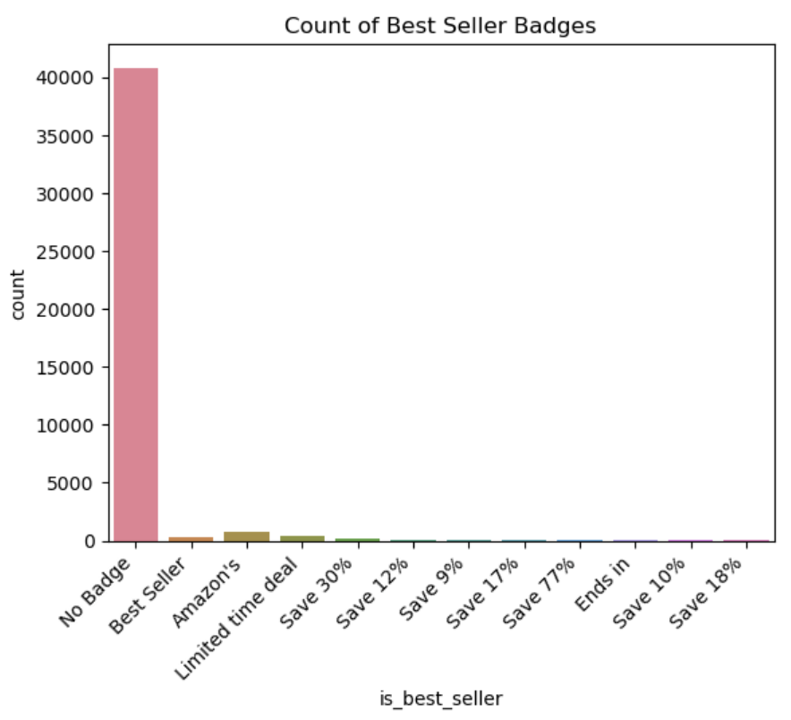
Best Seller Badges
Most products have no Best Seller badge.
Badges like “Best Seller” or “Amazon’s Choice” are rare exceptions.
When present, badges may act as strong signals, but most products compete without them.
Notes:
This chart shows the count of Best Seller badges across products. The majority of items don’t have any badge at all, which means badges are relatively rare in the dataset. Badges like Best Seller or Amazon’s Choice do exist, but they’re exceptions rather than the rule. Because of this, their influence may be concentrated in specific niches or categories rather than affecting the broader market. That said, when badges do appear, they can serve as powerful signals of credibility and visibility.

Slide 16
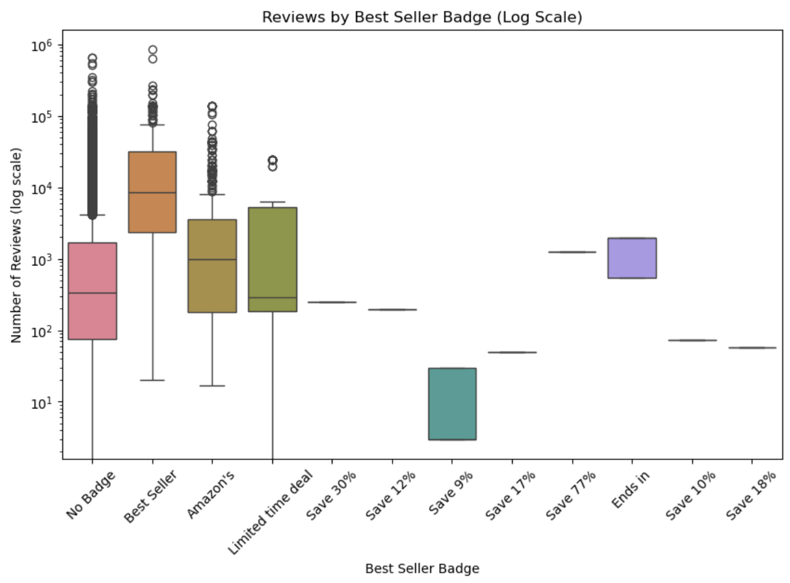
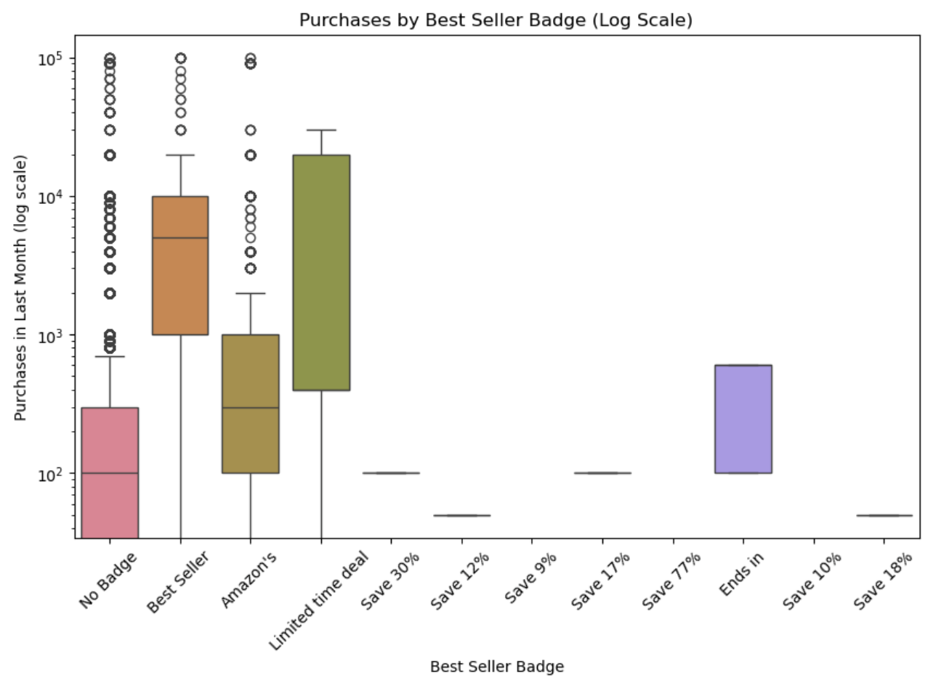
Effects of Best Seller Badges
Best Seller badge: strongest impact, with the highest purchases and reviews.
Amazon’s Choice and Limited Time Deal: moderate boost in purchases and reviews, but less consistent than Best Seller.
No Badge: majority of products, lower purchases and reviews.
Discount tags: very limited influence, low purchase and review activity.
Not all badges are equal. Best Seller acts as a powerful credibility marker, while others provide weaker or niche boosts.
Notes:
This analysis shows that not all badges are equal. The Best Seller badge has the strongest impact, driving the highest purchases and reviews. Amazon’s Choice and Limited Time Deal help somewhat, but most other badges, including discount tags, show little effect. Overall, Best Seller stands out as the most powerful credibility signal.

Slide 17

Random Forest Model
Results
TRAIN
R²: 0.97
RMSE: 986
Test
R²: 0.91
RMSE: 1,699
Small gap between train and test
Slight overfitting, but generalization is strong
Captures non-linear, complex relationships much better than Linear Regression.
Notes:
The Random Forest model that I tested to predict purchases achieved excellent results. On the training set, it reached an R² of 0.97 with a very low error, which shows it can fit the data very well. On the test set, the R² dropped slightly to 0.91 and the error increased to about 1,700. This gap indicates some overfitting, which is expected for Random Forests since they can memorize patterns. However, because the difference between training and testing performance is relatively small, the model is still generalizing well overall.

Slide 18
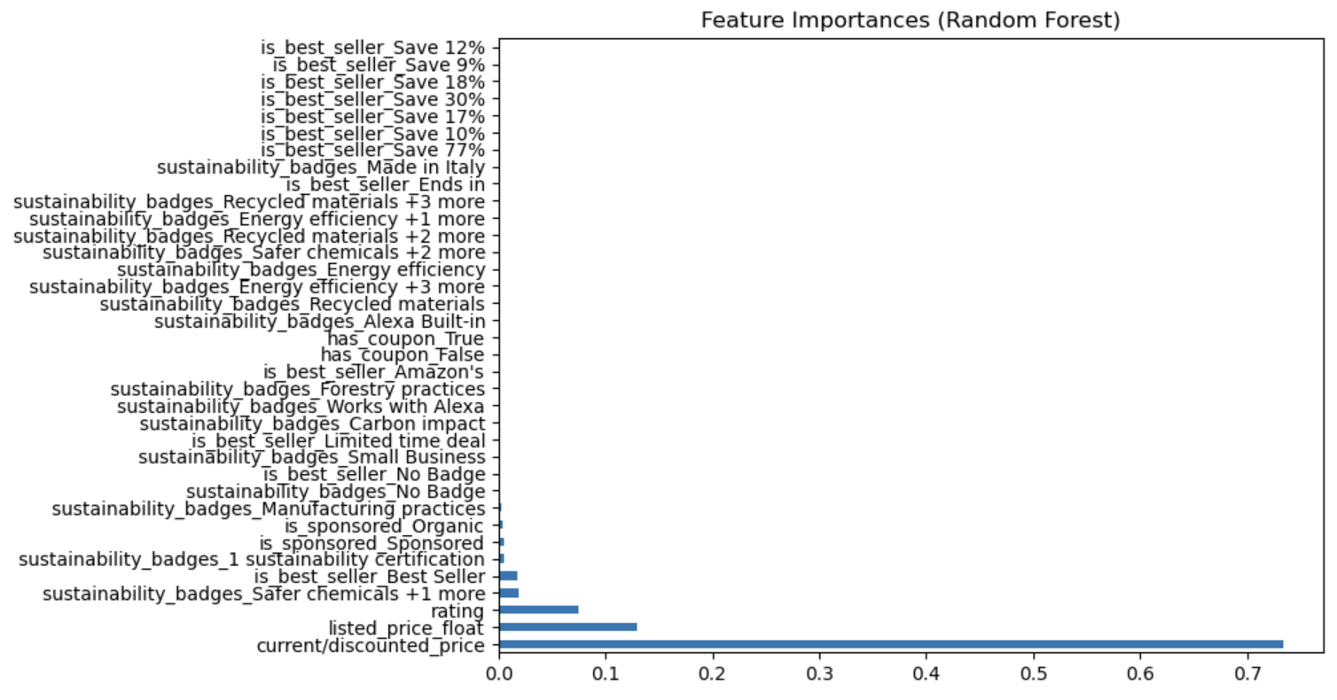
Random Forest Model
Feature Importances
Price (current/discounted) is the most important driver of purchases.
Listed price also matters, but less than discounted price.
Ratings, sponsorship, and best-seller badges have moderate influence.
Sustainability badges have a minimal effect
Niche rather than broad drivers
Confirms that pricing strategy is the strongest lever for sales
Notes:
When we look at feature importances from the Random Forest model, it becomes clear that price is by far the most important factor driving purchase activity. Specifically, current or discounted price has the strongest impact, while listed price also plays a meaningful but smaller role. Other factors such as ratings, sponsorship, and best-seller badges contribute to sales, but their influence is much weaker compared to price. Sustainability badges and certain niche labels show almost no effect, suggesting they appeal to smaller audiences but don’t move overall sales significantly. From a business perspective, this reinforces that pricing is the most effective lever for influencing purchase behavior.

Slide 19

Gradient Boosting Model
Results
TRAIN
R²: 0.86
RMSE: 2,026
Test
R²: 0.82
RMSE: 2,442
Explains ~82-86% of variance with moderate errors.
Less accurate than Random Forest, but balanced and stable.
Better suited when robustness and reduced overfitting matter more than raw accuracy.
Notes:
Gradient Boosting explains about 86% of the variance in training data and 82% in testing, with moderate prediction errors. Compared to Random Forest, it achieves lower raw accuracy but shows smaller gaps between train and test performance, indicating stronger robustness and less overfitting.

Slide 20
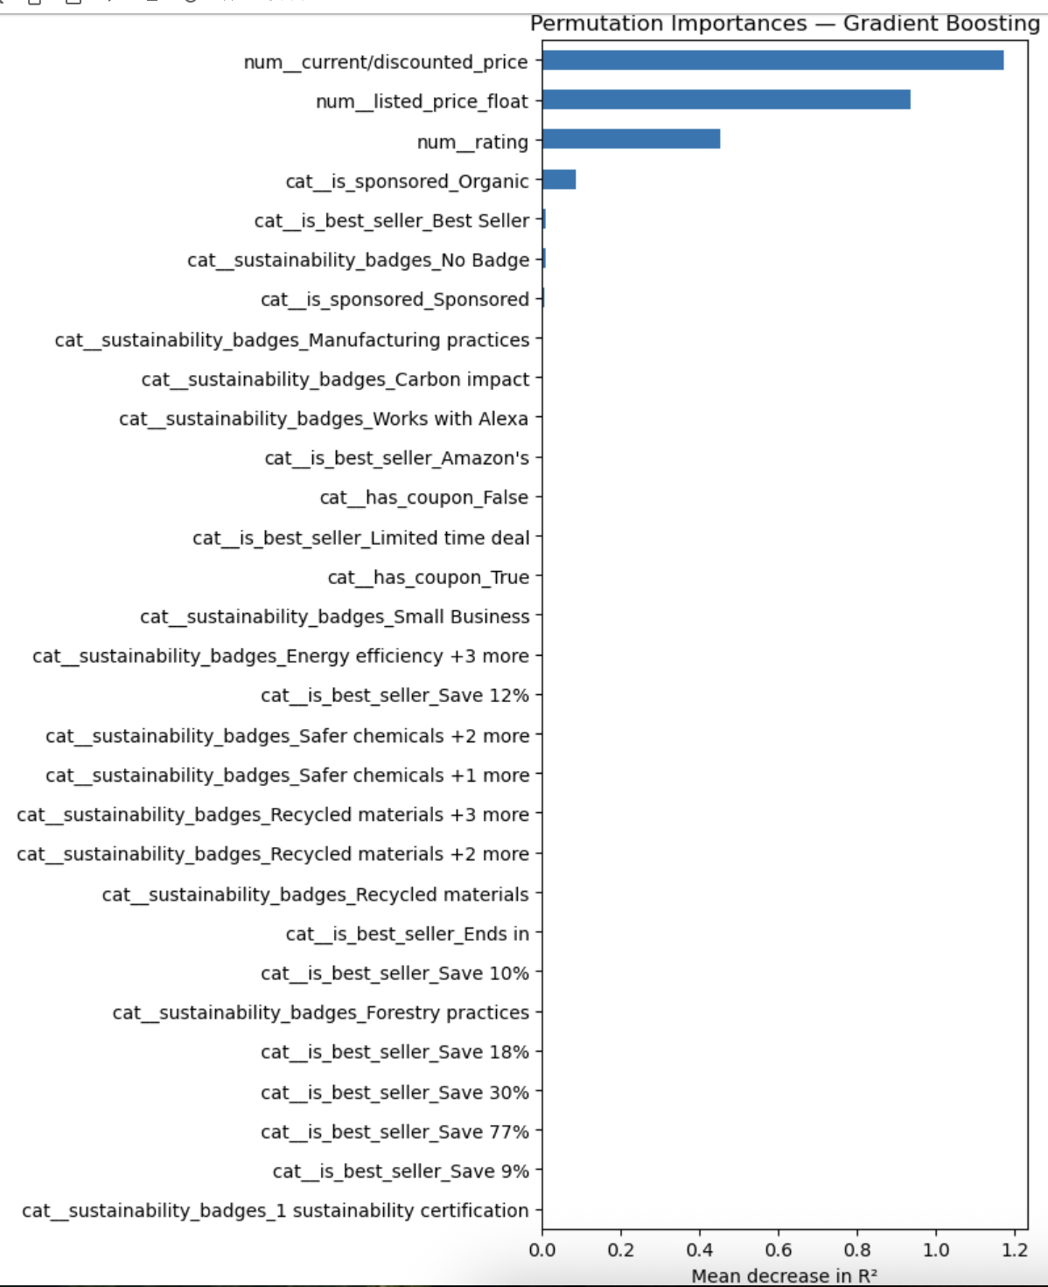
Gradient Boosting Model
Permutation Importances
Price and ratings are the strongest predictors of purchases.
Organic sponsorship has notable predictive power, more than other categorical features.
Best Seller adds some value, but weaker compared to price and ratings.
Coupons and sustainability badges contribute little to predictive accuracy.
Consumer behavior is mainly driven by cost and satisfaction signals.
Notes:
This slide shows that price and ratings are the strongest drivers of purchases, far outweighing other factors. The Organic tag also had notable influence, while badges like Best Seller and coupons mattered less. Overall, cost and customer satisfaction drive buying behavior, while most marketing and sustainability labels play a limited role.

Slide 21
Key Insights and Next Steps
Key Takeaways
Next Steps
Pricing dominates as the strongest driver of purchases.
Reviews fuel sales, but with diminishing returns.
Badges have mixed value: Best Seller helps, while sustainability badges mainly boost reviews, not sales.
Sponsorship boosts sales short-term but may lower ratings slightly.
Tree-based models far outperform Linear Regression.
Apply models to predict future product sales.
Explore interactions.
Ex. Low price + coupon + sponsorship
Extend to category-level analysis for deeper insights.
Notes:
To wrap up, this analysis shows that pricing is by far the most powerful driver of consumer behavior on Amazon. Reviews also matter, but their impact levels off once a product is already popular. Marketing signals like badges and sponsorships can help, but they play secondary roles compared to price and ratings.
From a modeling perspective, Random Forest and Gradient Boosting both perform very well, far outperforming Linear Regression by capturing the non-linear and complex dynamics in this dataset. Random Forest gives the best accuracy, while Gradient Boosting offers a more stable balance between training and test results.
Looking ahead, these models could be extended to predict future sales trends or tested across product categories. Overall, the results highlight actionable levers, like pricing and discount strategy, that sellers can use to maximize performance.

